Slide 1

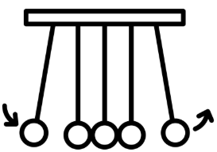

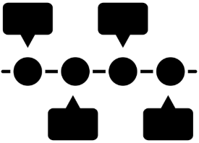




History - To enable all our children to lead physically and mentally healthy lives, ensuring every child THRIVES in their learning during their time at Broughton Community Schools.
Our History curriculum inspires pupils’ curiosity about the past, helping them to understand how it shapes the world which they live in today.
Our bespoke history curriculum aims to support children in making meaningful connections between past and present, equipping pupils with the knowledge and skills to think critically, ask thoughtful questions, and reason using historical evidence. Through clear and progressive teaching, pupils develop an understanding of change and continuity over time, as well as the diversity of societies and cultures. By exploring our local areas, children will understand their own identity, community and how the past influences modern life. Our curriculum enables them to better understand the challenges of their time. By exploring different perspectives and experiences, pupils are prepared to become informed, reflective, and engaged citizens.
History Concepts
How a historian understands, interprets and explains the past:
Cause and consequence
Time, change and chronology
Historical significance
Historical enquiry
Source reliability and interpretation
Local history
SMSC in our History curriculum
Encouraging pupils to develop a sense of wonder and curiosity about the past, helping them reflect on human experiences, beliefs, and values.
Providing opportunities to discuss fairness, justice, courage, and responsibility.
Exploring different communities and roles, pupils develop respect for others and an understanding of how cooperation and conflict have shaped societies.
Appreciating the contributions of different cultures to British and world history, promoting mutual respect and tolerance.
Our History curriculum ensures that all vulnerable children achieve, belong and thrive
Through task design, teaching is delivered in a mastery approach: low ceiling, high ceiling model.
A clear lesson structure ensures children have the opportunity to orally rehearse and work with others before independent practice.
Tier 2 and tier 3 vocabulary is explicitly taught and applied in task design.
Adapted tasks are used to support independence. This includes Widgets, sentence stems and word banks.
Enrichment opportunities for each topic enhances a deeper understanding.
Assessment
How do we check that the knowledge is retained?
Thrives in Fives retrieval practice.
Assessment throughout the lesson, e.g. whiteboards, feedback, oral rehearsal.
Re-activate tasks in the following lesson.
End of unit assessments.
What do we do if a child has not retained the knowledge?
Catch up, keep up at the end of the unit for individual children.
Core knowledge added to retrieval in next unit.

Slide 2
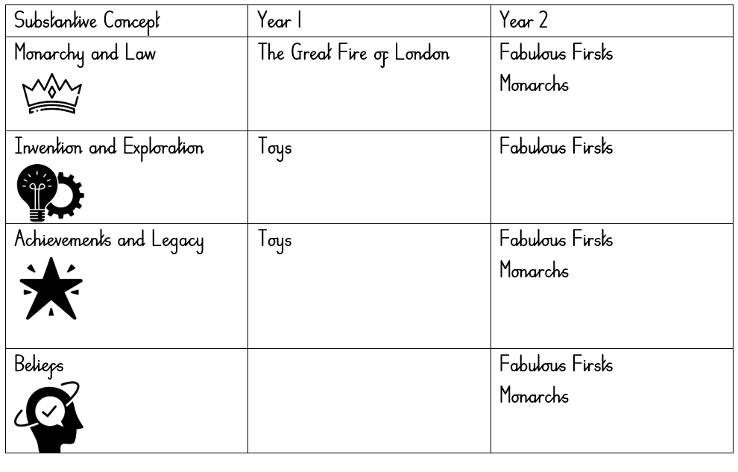
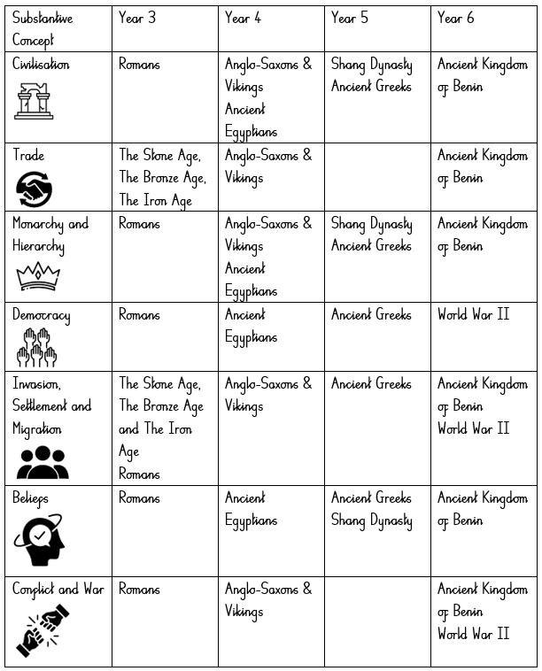
History - To enable all our children to lead physically and mentally healthy lives, ensuring every child THRIVES in their learning during their time at Broughton Community Schools.
Substantive concepts are concepts concerned with the subject matter of history: they are embedded throughout the curriculum – golden threads weaved so that each one is planned to be encountered multiple times throughout the curriculum. At Broughton, we teach our golden threads through repeated encounters in specific, meaningful contexts:
Disciplinary knowledge is knowledge about how historians investigate the past, and how they construct historical claims, arguments and accounts. It is concerned with developing historical rational and critical thinking within enquiry. Our Broughton history curriculum categorises five Disciplinary concepts:
• Cause - selecting and combining information that might be deemed a cause and shaping it into a coherent causal explanation and Consequence - understanding the relationship between an event and other future events.
• Time, change and chronology - analysing the pace, nature and extent of change and when this happened.
• Historical significance - understanding how and why historical events, trends and individuals are thought of as being important.
• Historical Enquiry - asking questions, using sources and evidence to construct and challenge the past.
• Historical interpretations - understanding how and why different accounts of the past are constructed.

