Slide 1


Emotional Regulation Skills

Slide 2
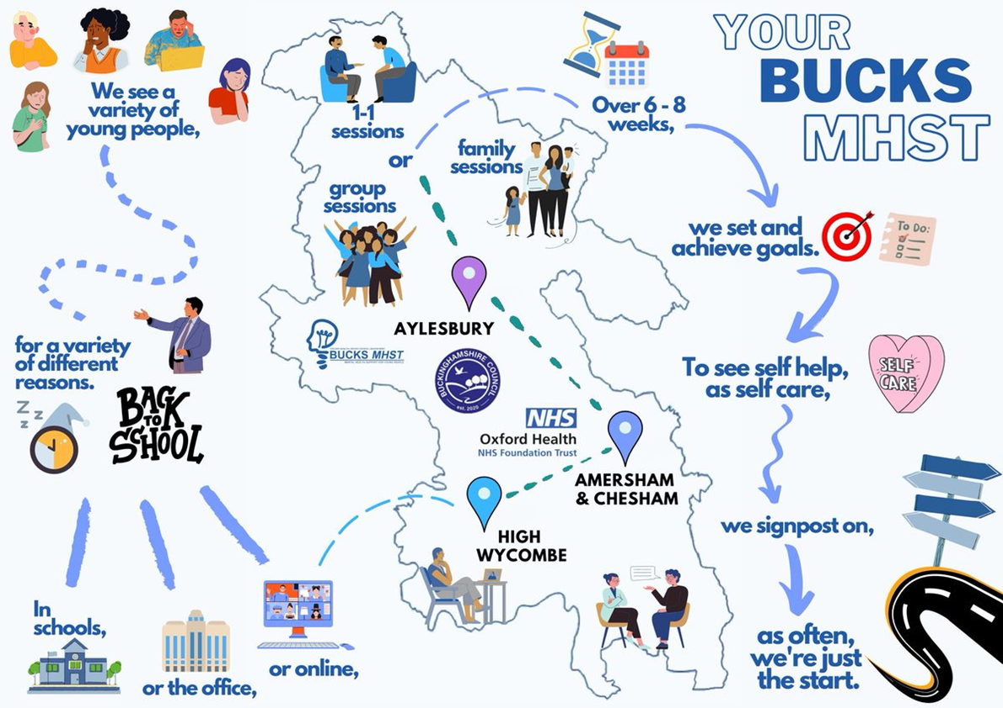
Who are We?
Grace Wardle– Education Mental Health Practitioner – School Link Worker

Slide 3
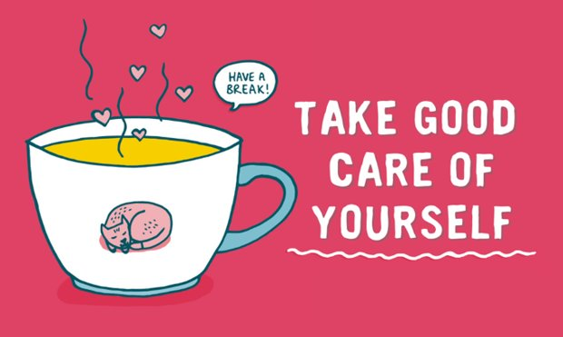
Before we start
This is not about turning you into therapists
It aims to support those who want to feel more confident with responding to their child when they are dysregulated and with imputing wellbeing strategies.
We can’t go into personal child‑specific concerns during the session, but will be available for questions at the end.

Slide 4
What we will cover today
Mental Health and MHST Overview
CBT Cycle
Social and Emotional Skills (flipping you lid model)
Ways to Support your child
Additional Training for you
Free resources for you to use
Relaxation Strategies

Slide 5

What would you like to get out of this session?

Slide 6

Background
50% of mental health difficulties are established by age 14 and 75% by aged 24*
In light of this statistic, the MHST is about prevention. Our aim and vision is to work with the whole school community to encourage resilience and educate staff, students and parents to prevent poor mental health in children and young people
‘Transforming Children and Young People’s Mental Health Provision – a Green Paper’ https://www.gov.uk/government/consultations/transforming-children-and-young-peoples-mental-health-provision-a-green-paper
*https://www.mentalhealth.org.uk/statistics/mental-health-statistics-children-and-young-people

Slide 7
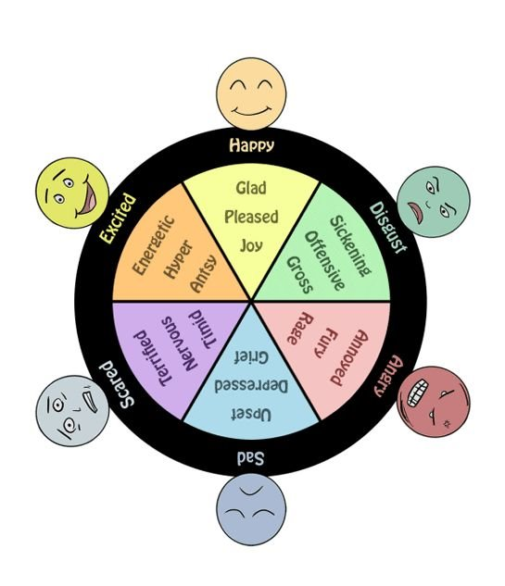
WHAT is emotional regulation?
Helping children identify and manage their feelings and behaviour and build self-control​
handle and overcome difficulties​
make good decisions​
build resilience, self-esteem and confidence​
think positively about themselves and how they perceive the world around them

Slide 8
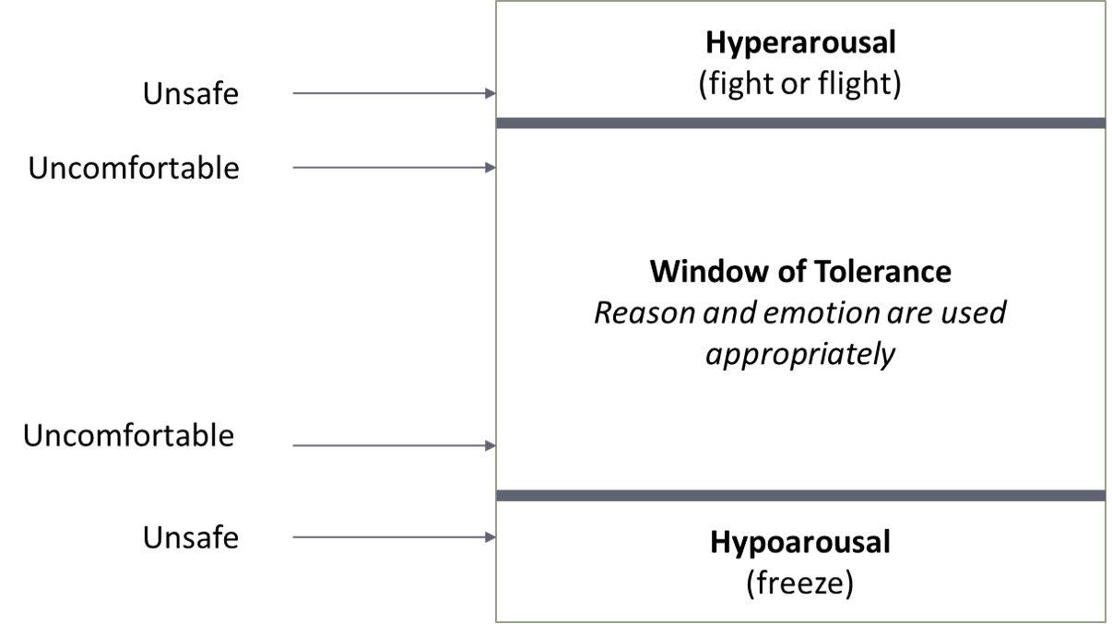
WHAT IS EMOTION REGULATION?
The ability to manage our emotions and how we react to them, to stay within our 'window of tolerance'.
This Photo by Unknown author is licensed under CC BY.

Slide 9
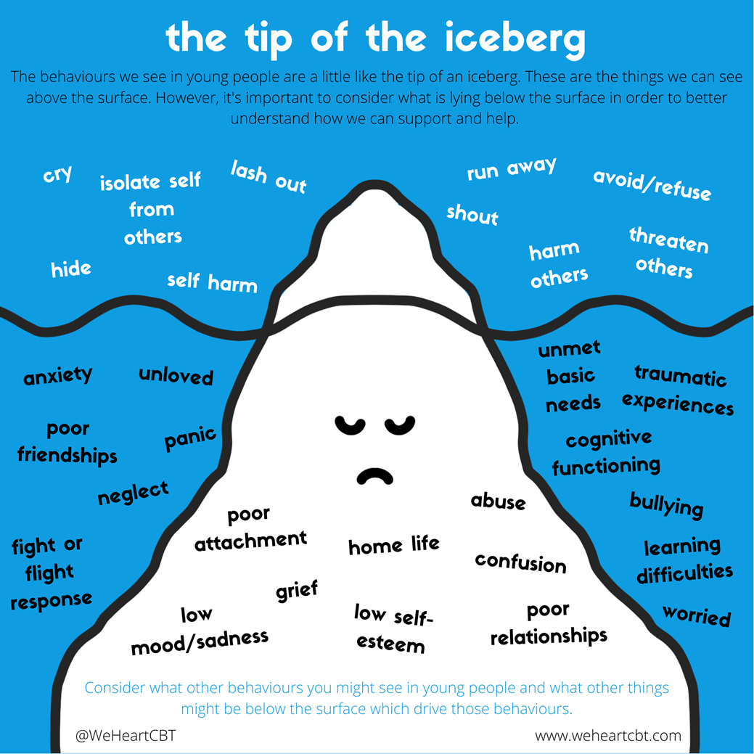
Context Matters

Slide 10
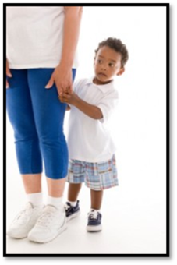
Remember
All children and young people (and adults) have changes in mood, and ups and downs
Being fearful and some changes in behaviour are very common during childhood
Consider whether it is developmentally appropriate

Slide 11
Worried about coming into school in the morning
THOUGHTS
Something might happen to my family whilst I’m at school
PHYSICAL REACTIONS
FEELINGS
Feeling sick
Heart racing
Can’t concentrate
Scared
Stressed
Panicked
BEHAVIOURS
Not coming into school
Delaying getting ready
Constant check-ins

Slide 12
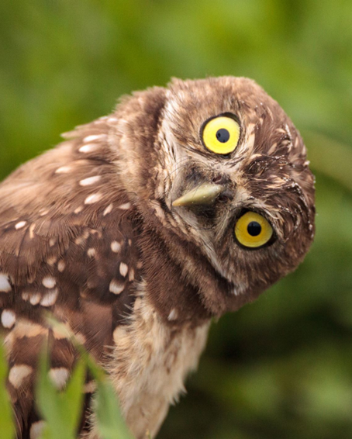
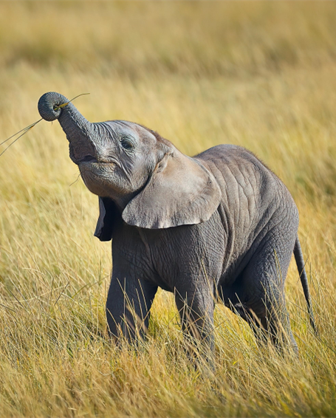

The three brains
Three parts in our brain
They need to work together to access memory
When you are over stressed – they stop collaborating
We are going to call them: elephant brain, meerkat brain, and owl brain

Slide 13
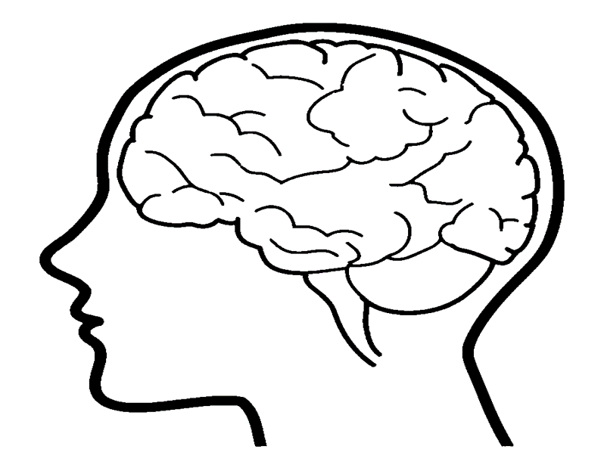

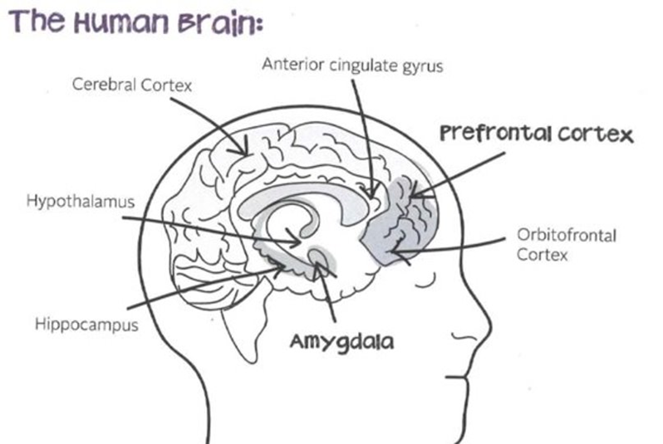
Understanding our brain
Pre-Frontal Cortex (Owl) is where we process information so we can compute, decide, analyse and reason.
The catch is that the amygdala (Meerkat) needs to be calm for this to happen.
It will then focus anything worth remembering to the Hippocampus (Elephant)

Slide 14
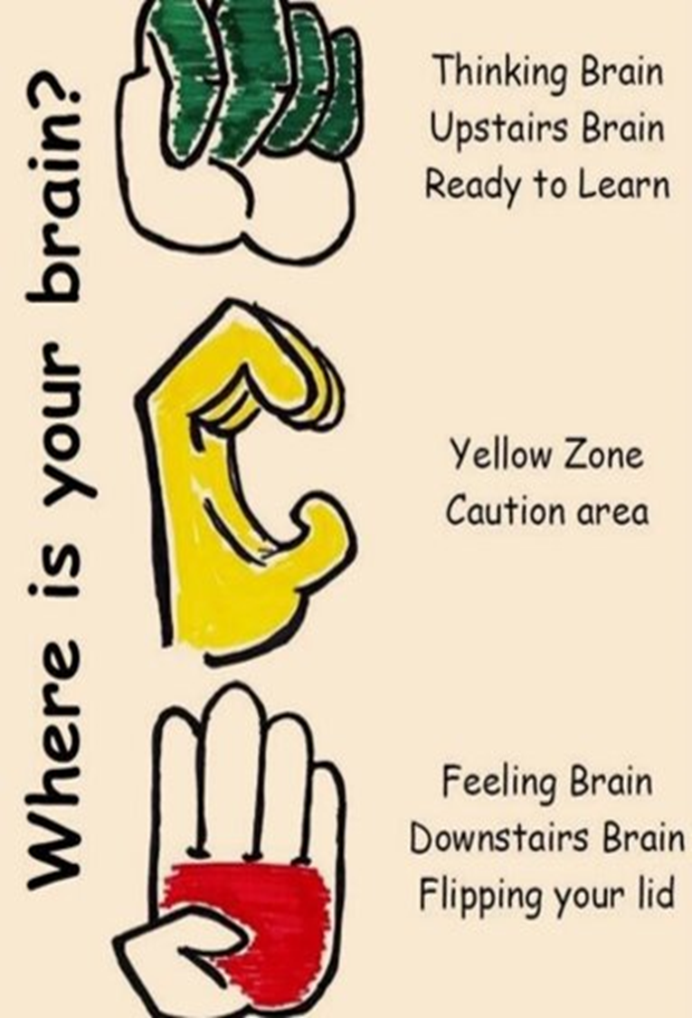
The hand model of the brain – Flipping the lid
Knowing our brain is the key
Knowing when the ‘warning wobble’ is coming
Learn our own signs of stress
We can learn techniques to calm our brain

Slide 15
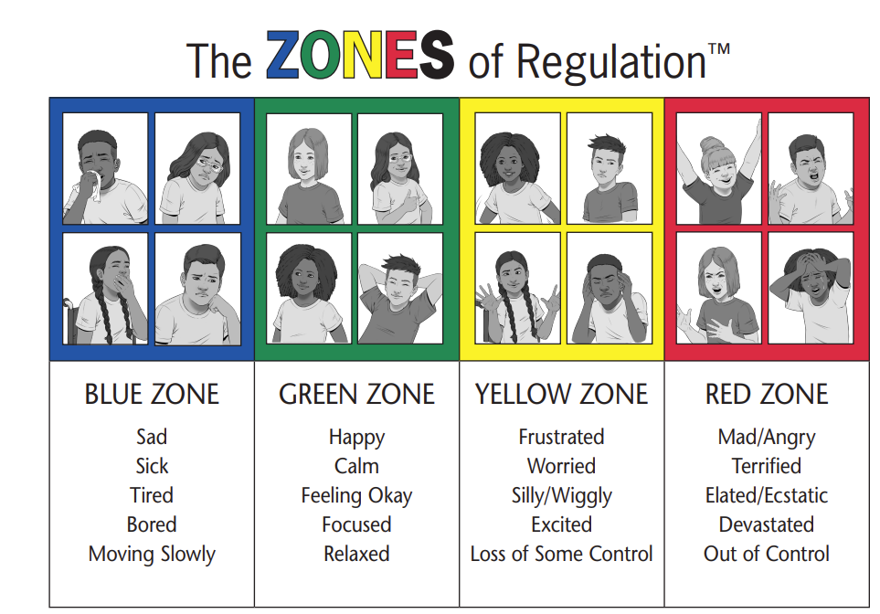
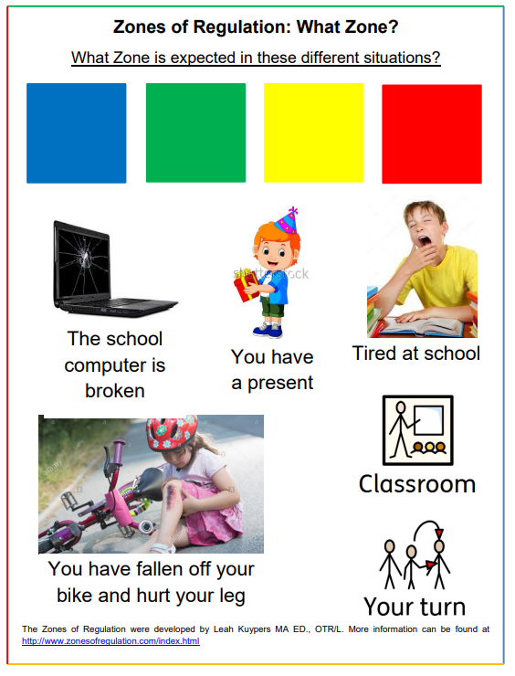
Zones of Regulation

Slide 16
What is an emotion regulation toolbox?
Emotion regulation toolbox
Physical tools
Feel good tools
Emotional tools
Relaxation tools
Sensory tools
Notes:
An emotion regulation toolbox to help us better manage big or uncomfortable emotions:
Emotional regulation means being able to manage when we feel the big or uncomfortable emotions, and having ways to get back to calm.

Slide 17

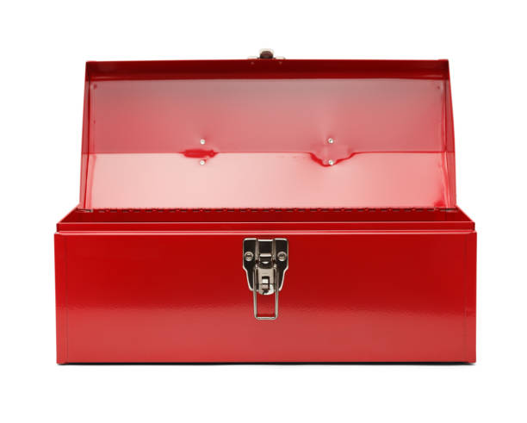
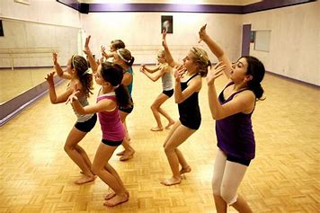
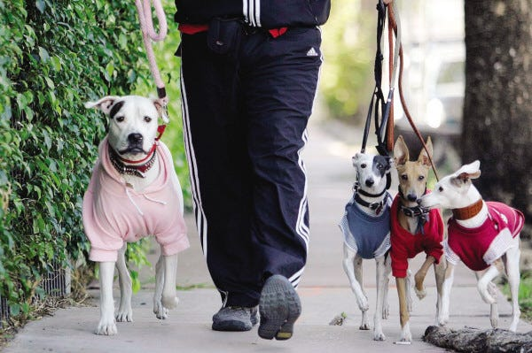
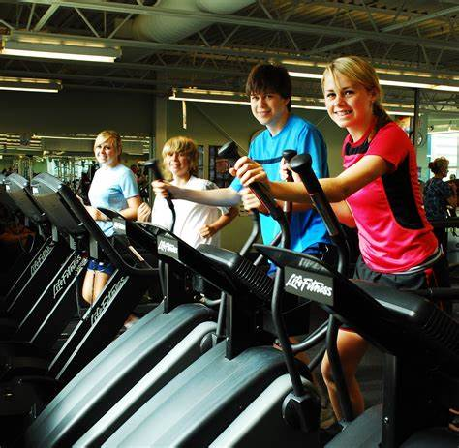
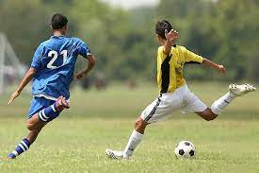
Physical tools
Walking/Running
Dance
Physical Tools
Improve wellbeing and energy levels
Walking the dog
Gym
Football
Notes:
Let’s think about tools that can help get us moving. When we move or do exercise, it can help us feel good and give us energy. Which moving tool could you put in your box? What do you enjoy most?

Slide 18

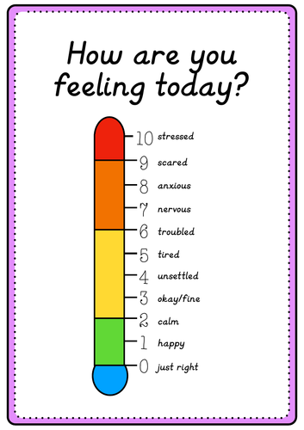
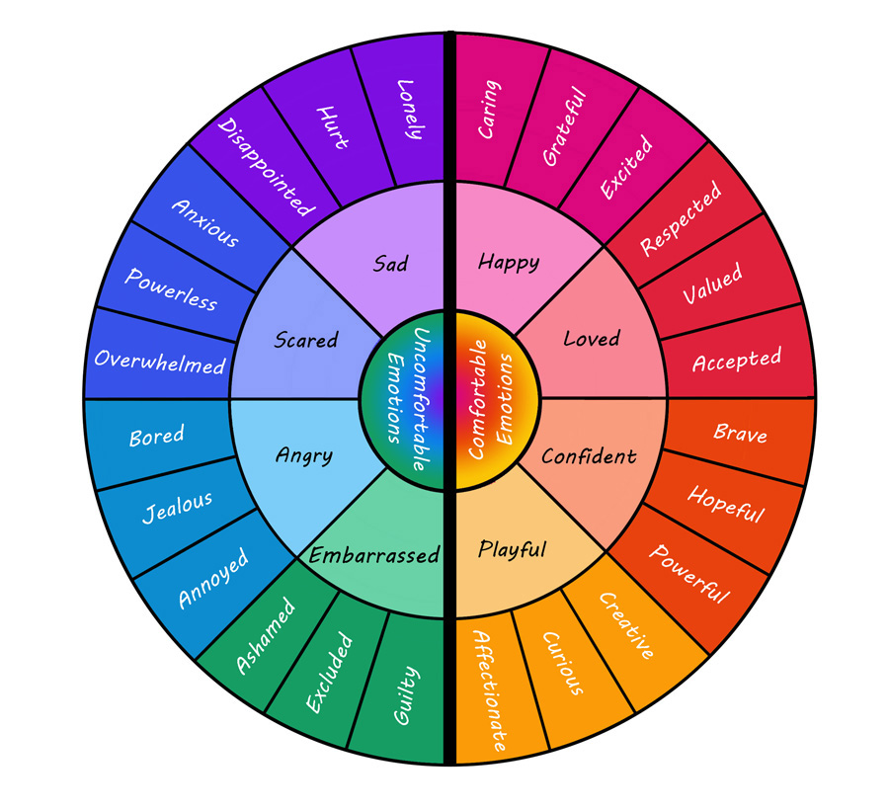
Emotional tools
Awareness of bodily sensations
Emotional Tools
Emotion wheel(s)
Emotion Thermometers
Notes:
Lets think about which emotional tools might be helpful for us know. Using tools that help us understand emotions we are feeling help us understand ourselves and situations better which improves our wellbeing. Which one do you think might be most helpful for you? Is there a new one you would like to try?

Slide 19
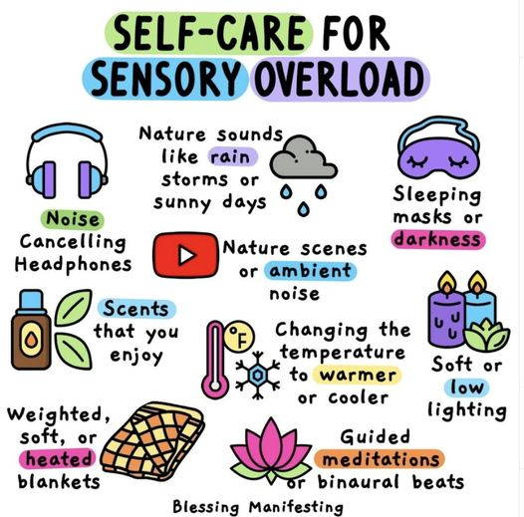
Sensory tools
Sensory Tools
Notes:
What can I do to support myself when overwhelmed by my senses?
Here are some examples:
Use scents you enjoy
Watching nature scene videos or ambient (background hum) noise
Nature sounds such as rain, storms, or sunny days
Soft or low lighting
Noise cancelling headphones (defenders)
Weighted, soft, or heated blankets
Changing the temperature to be warmer or cooler
Sleeping masks or darkness

Slide 20

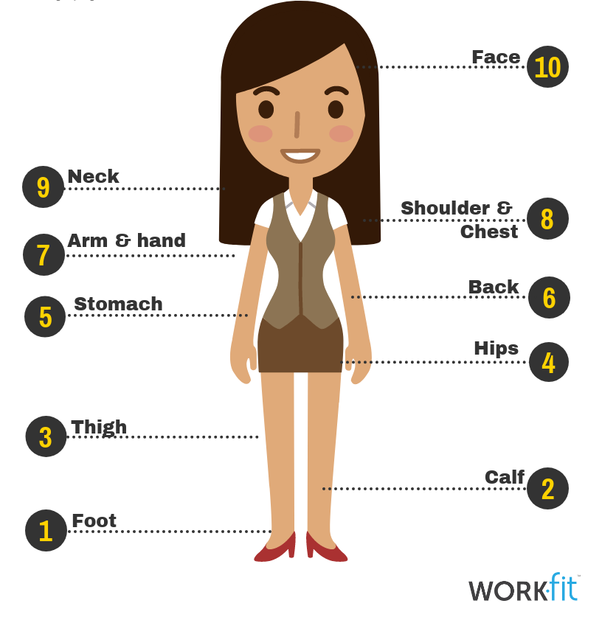



Relaxation tools
Time in Nature
Deep Breathing
Progressive Muscle Relaxation (PMR)
Relaxation Tools
e.g. calming activities
Quiet alone time
Being with a pet
Music
Notes:
Relaxation tools are very important too and things like time in nature, quiet time alone, listening to music and being with and stroking animals are all possibilities. What are your favourite ways to relax? Do you have a pet that helps you feel calm when you are with them?

Slide 21
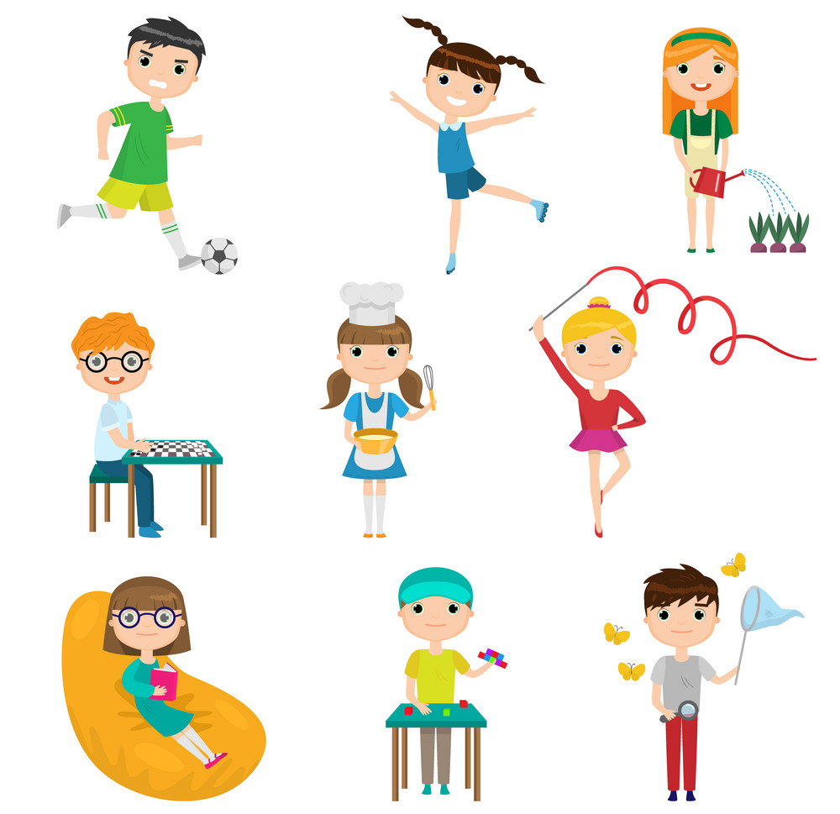
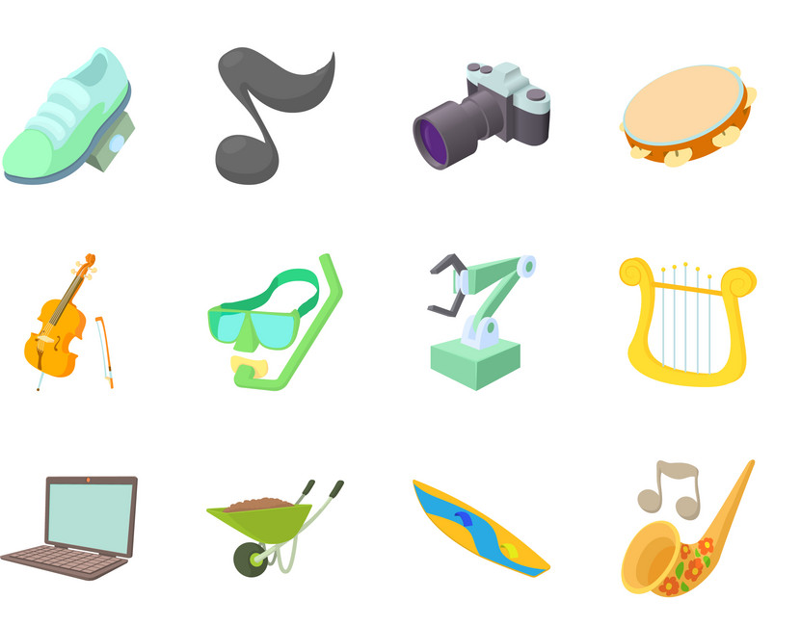
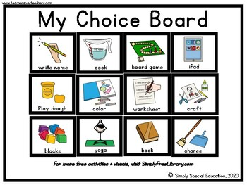
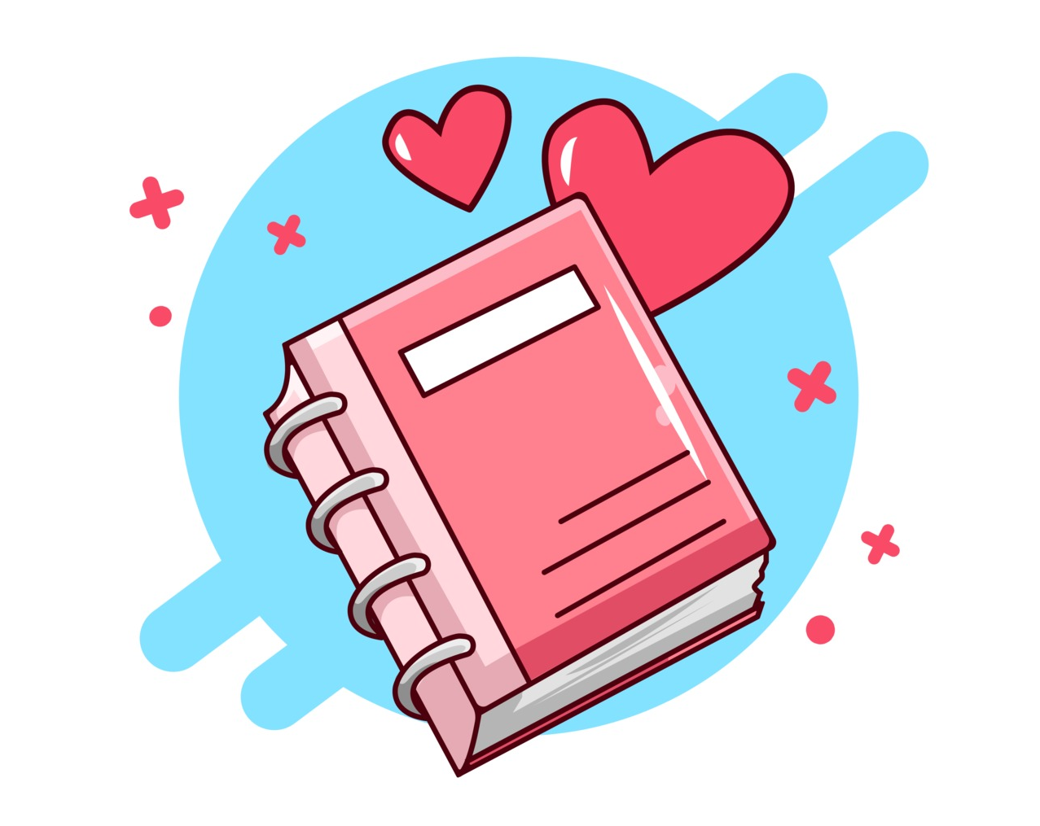
Feel good tools
Hobbies
Interests
Feel good tools
Create a Choice board
Create a gratitude diary
Notes:
Doing something we have enjoyed in the past can help us feel better.
Focus on our passions or special interests – what are these for each of us? This helps us overcome more negative emotions / thoughts.
Creating a choice board of things that we really love.
Creating a gratitude diary which helps us remember something we are grateful for each day e.g., my dog or recalling something we have done to help someone else e.g., gardening with my dad.

Slide 22
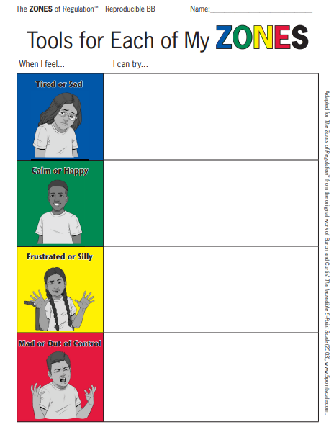
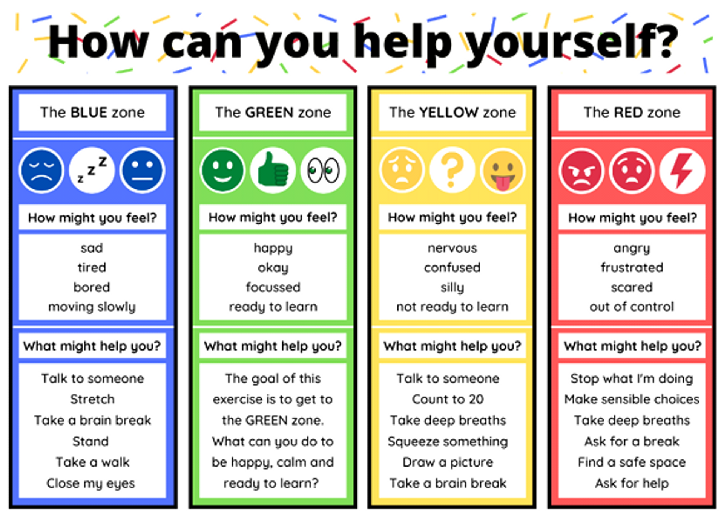
Practical tips
Notes:
Encouraging each child to have a thing that works for them. It's good for them to know what to do when in each zone.

Slide 23
How can we support a child to move from the red to the green zone?
Go for a walk
Colouring
Quiet zone
Reading
Play
Count to 10
Breathing exercises
Ask them questions about how they’re feeling and help them work though it
Avoid long explanations. Keep it brief and supportive whilst in the red zone.

Slide 24
Practical tips
Reframe your own thoughts Swap “They’re doing this on purpose” for “They’re overwhelmed right now.”
Validate your child’s feelings Acknowledge their emotion before guiding behaviour (“That was tough for you”).
Use calm, predictable limits Emotions are allowed; harmful behaviours are not.
Regulate yourself first Take a breath or step away briefly before responding.
Model coping skills Show your child how you calm down — deep breaths, counting, stretching.
Create a regulation toolkit Include sensory tools, movement breaks, calming activities, and positive self‑talk.
Schedule “worry time” Contain anxious thoughts by setting a daily time to talk them through.
Break tasks into small steps Reduce overwhelm by tackling one manageable piece at a time.
Praise effort, not outcome Reinforces resilience and reduces perfectionism.
Stay consistent with boundaries Predictability lowers stress and supports emotional stability.

Slide 25
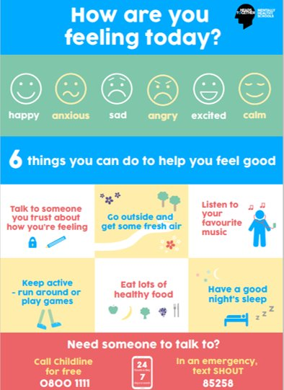
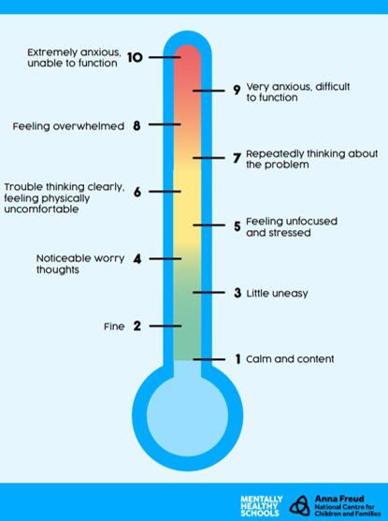
Resources

Slide 26
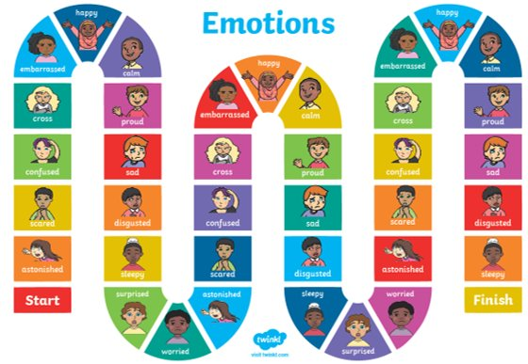
The smartie game
Step 1
Write a list of all the colours in a pack of Smarties
Step 2
Ask the child to tell you what each colour means in terms of an emotion i.e yellow – happy, purple – embarrassed
Step 3
Surprise them with the pack of Smarties and give them a few
Step 4
Ask the child to pick a Smartie to explain a time they have felt the emotion from the list
Step 5
When the child has shared their experience, validate and normalise their experience and finally…
Let them eat the Smarties!

Slide 27
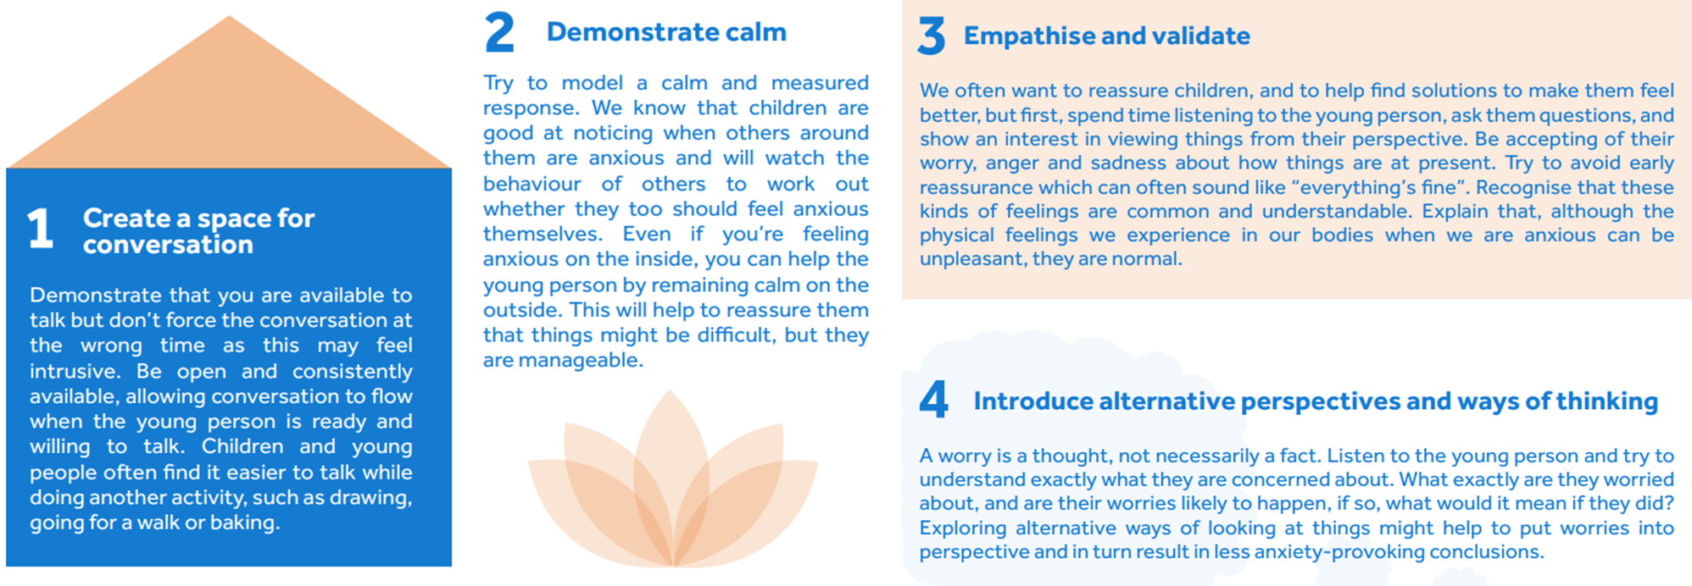
7 ways to support children who worry

Slide 28
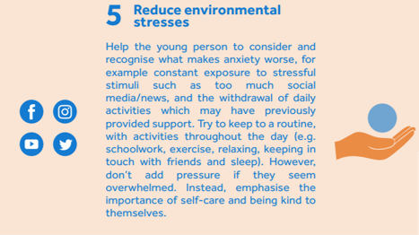
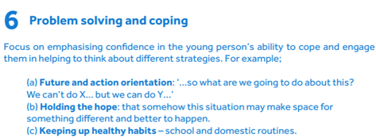
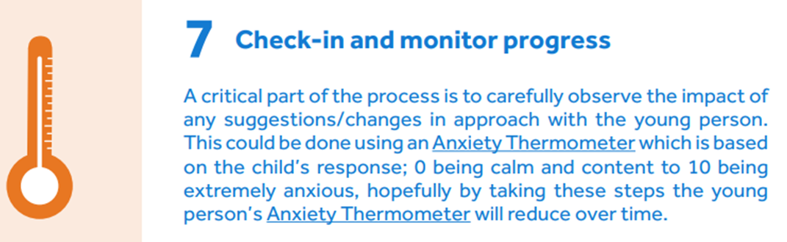
7 ways to support children who worry

Slide 29
Starting the conversation
Potential conversation starters:
You don’t seem your usual self today. Would you like to talk about anything?
You look sad/worried today. Do you want to have a chat about it/is there anything I can do to help?
You said something interesting earlier about how you felt when… How do you feel about it now?

Slide 30
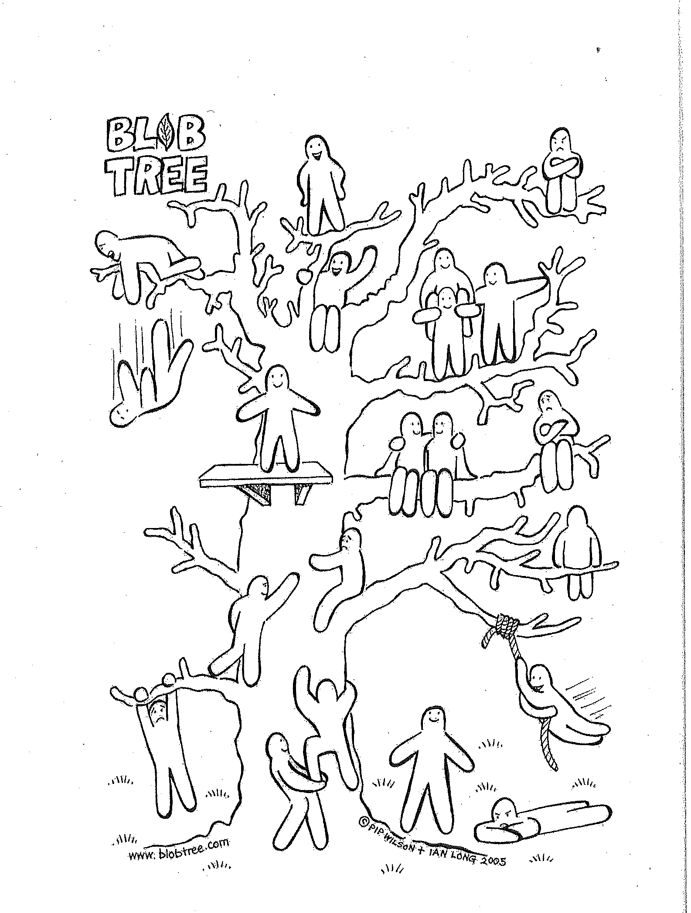
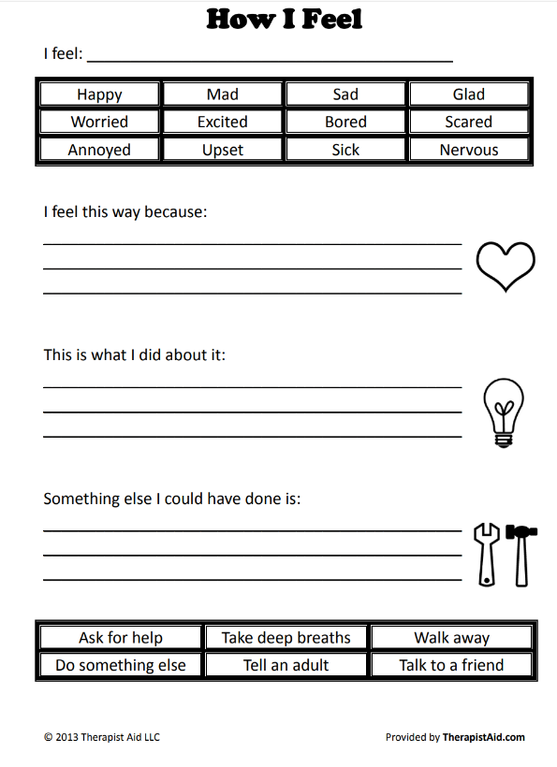
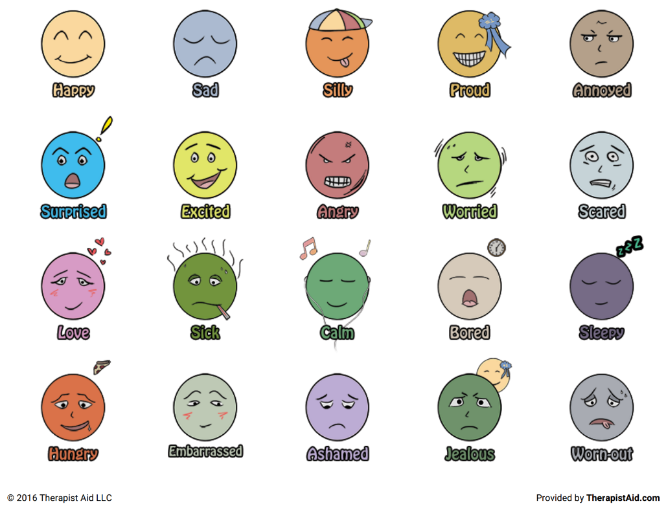
Starting the conversation

Slide 31
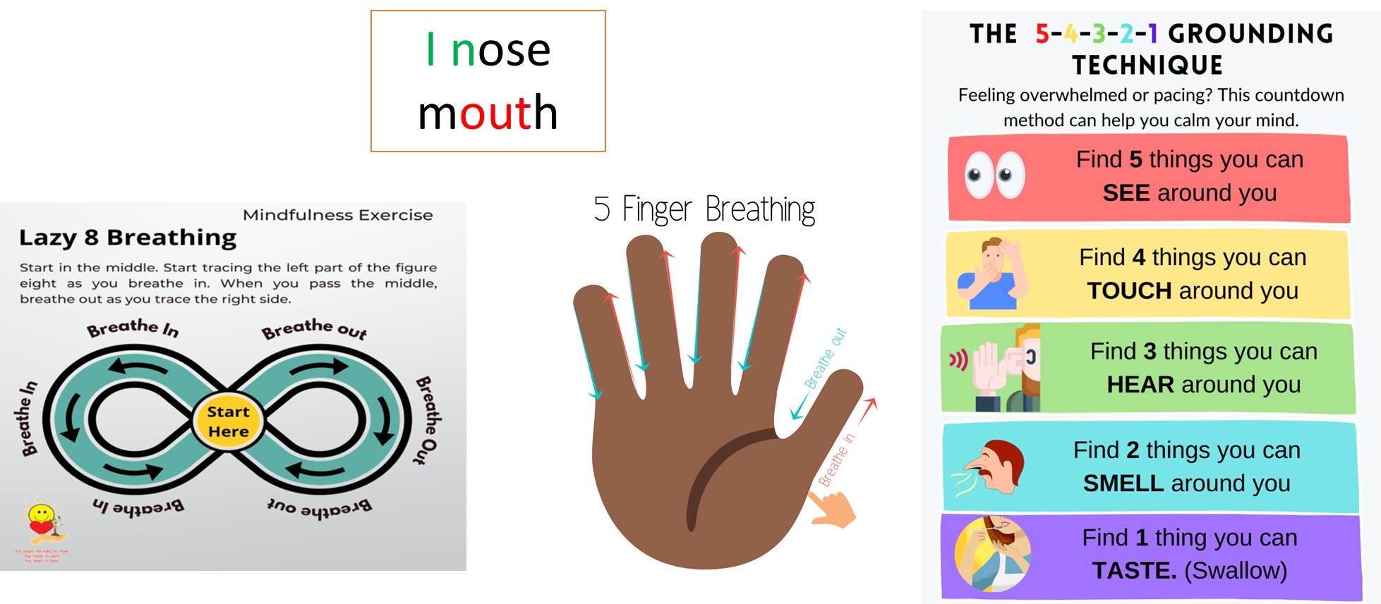
Relaxation and Grounding Techniques

Slide 32
Useful Websites
Anxiety UK
www.anxietyuk.org.uk
Mind
www.mind.org.uk
Rethink Mental Illness
www.rethink.org
ELSA Support
Provides information, resources and blogs on emotional literacy
https://www.elsa-support.co.uk/
Save the children
Emotional intelligence resources for parents
NHS, Every Mind Matters
www.nhs.uk/every-mind-matters
https://www.savethechildren.org.uk
Anna Freud
Information on child development and promoting young children’s self-regulation skills through play
https://www.annafreud.org/

Slide 33

Thank you for listening.

