Slide 1
Welcome
&
Thank you for coming
All about Multiplication

Slide 2
Why is mental maths important?
In a nutshell, it helps children to develop problem-solving skills that promote faster calculations.
It also allows children to see the relationship between numbers and the patterns they make.
Times tables are required for fraction work, algebra, area, volume, etc.
Video to watch:
https://ttrockstars.com/parents/

Slide 3
Year 6 SATs
In 2018 Paper 1 (Arithmetic) there were 19 out of 36 questions which definitely required children to have a fluent knowledge of the times tables.
In Papers 2 and 3 (Reasoning) 18 out of 44 questions also required children to have a fluent knowledge of the times tables.
This will be the case when completing GCSEs & A levels.

Slide 4

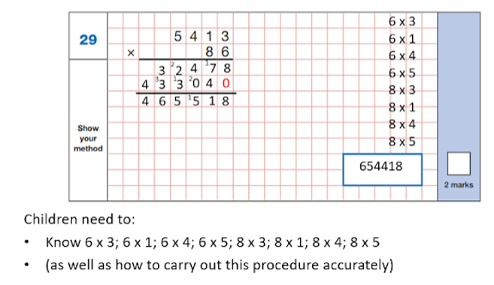

Slide 5
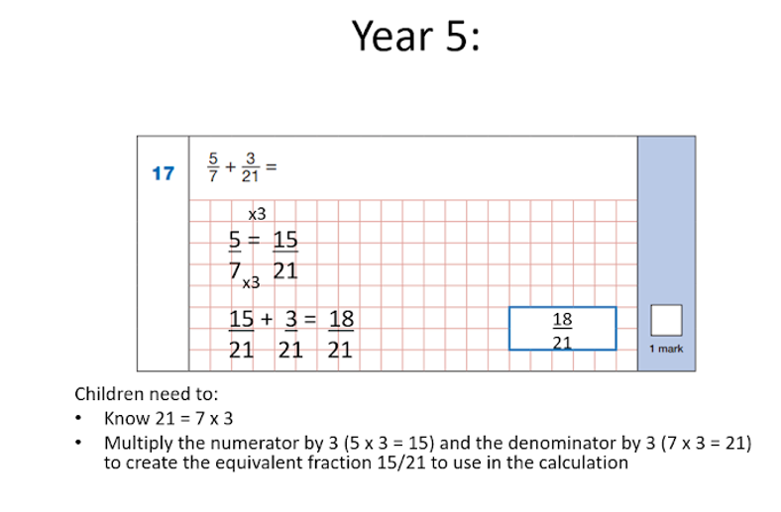

Slide 6
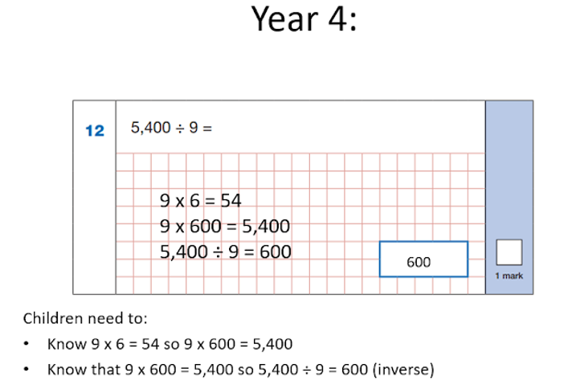

Slide 7
Children need to be able to recall the answer to any times table within 2 or 3 seconds.
That leaves no time for counting the way up to the answer from 2x, 3x, 4x, etc – the answer has to pop out of memory pretty much instantly.
This level of ‘number fluency’ is the ideal foundation for any child.

Slide 8
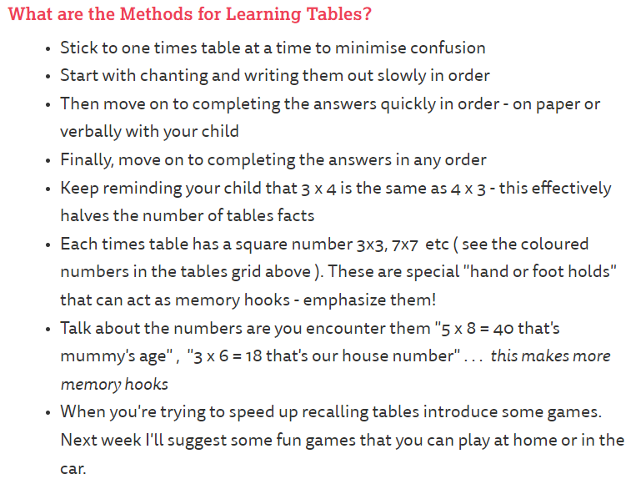
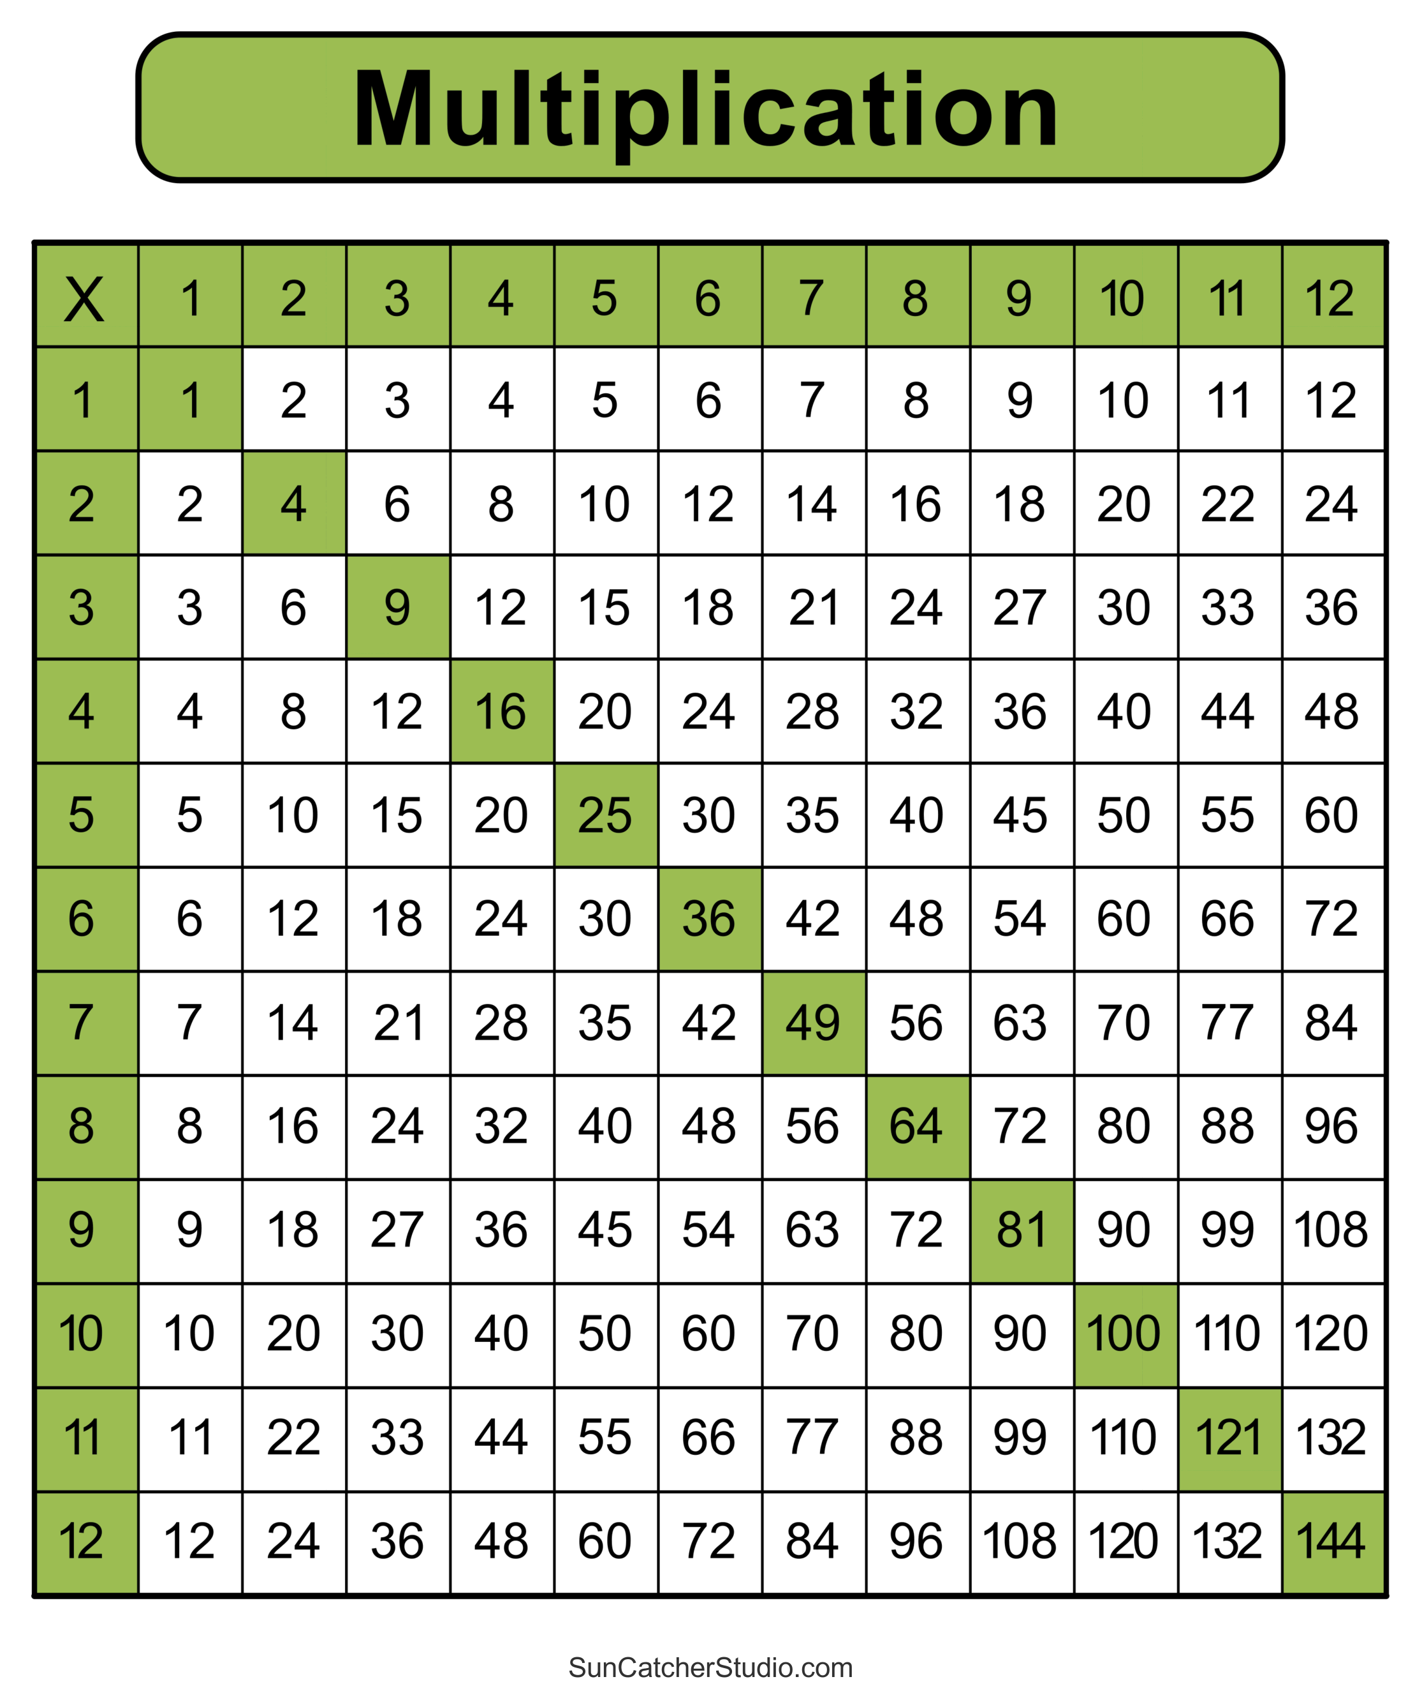

Slide 9
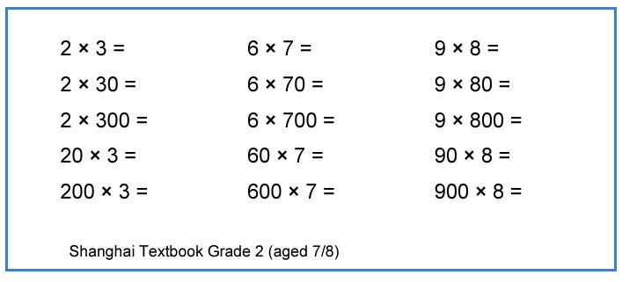
How times tables can be applied:

Slide 10
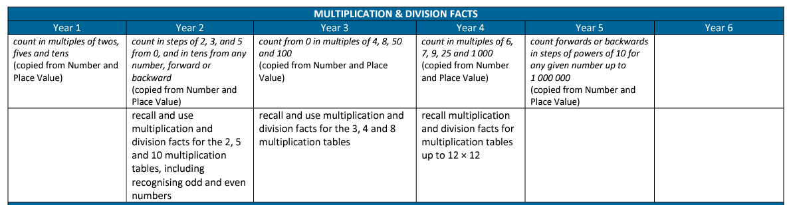

Slide 11
Year 2 - 2s, 5s, 10s & start 3s
Year 3 - 4s and 8s
Year 4 – all tables to 12×12

Slide 12
Mental skills you can practice at home:
Times tables
Number Bonds within 10
Number Bonds to 10
Number Bonds to 20
Number Bonds to 100
Doubles
Near Doubles

Slide 13
Year 4 Multiplication Tables Check
Your child will be participating in the multiplication tables check (MTC) in June.
The purpose of the check is to determine whether your child can fluently recall their times tables up to 12, which is essential for future success in mathematics. It will also help your child’s school to identify if your child may need additional support.

Slide 14
What is the multiplication tables check?
It is an onscreen check consisting of 25 times table questions.
Your child will be able to answer 3 practice questions before taking the actual check.
They will then have 6 seconds to answer each question.
On average, the check should take no longer than 5 minutes to complete.

Slide 15
Schools will have unlimited access to a ‘try it out’ area from April.
They can use this to make sure pupils have the necessary support to access the check.
This includes opportunities for pupils to familiarise themselves with the check application and try out any access arrangements that may be required.

Slide 16
What are we doing in school?
Daily times tables booklets practise
Mock tests each week
Half termly times table grid assessment
Mastering Number
99 Club
TT Rockstars – including our leaderboards

Slide 17
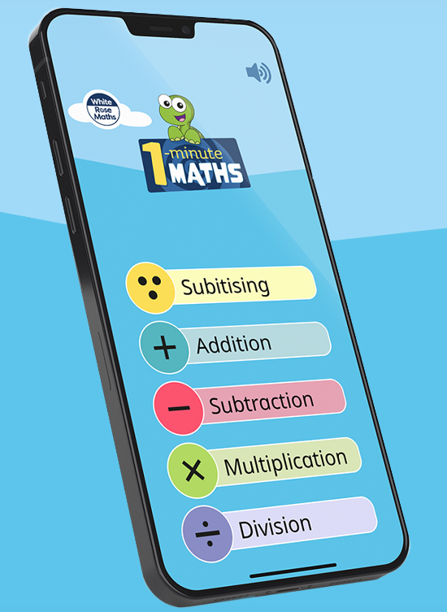
Websites to use at home:
TTRockstars - https://ttrockstars.com/
Topmarks - https://www.topmarks.co.uk/
White Rose – 1 minute maths
app.
www.timestables.co.uk
Hit the Button

Slide 18


https://ttrockstars.com/parents/

Slide 19
Thank you for listening.
We will email all Year 4 parents/carers this PowerPoint and it will be available on the school website.

