Slide 1
Multiplication

Slide 2
Why is mental maths important?
In a nutshell, it helps children to develop problem-solving skills that promote faster calculations.
It also allows children to see the relationship between numbers and the patterns they make.
Times tables are required for fraction work, algebra, area, volume, etc.

Slide 3
Year 6 SATs
In 2018 Paper 1 (Arithmetic) there were 19 out of 36 questions which definitely required children to have a fluent knowledge of the times tables.
In Papers 2 and 3 (Reasoning) 18 out of 44 questions also required children to have a fluent knowledge of the times tables.
This will be the case when completing GCSEs & A levels.

Slide 4

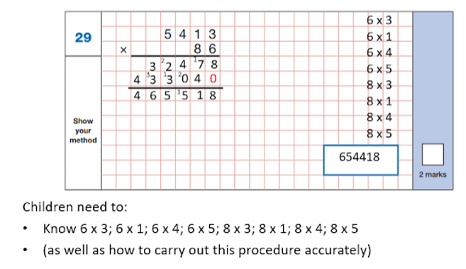

Slide 5
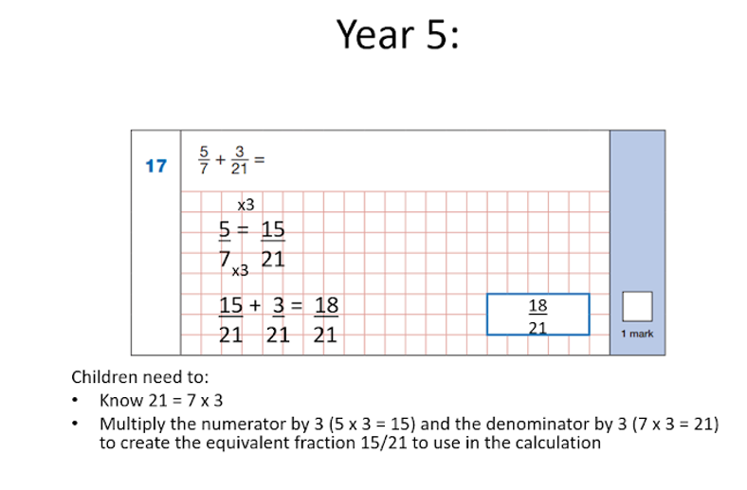

Slide 6
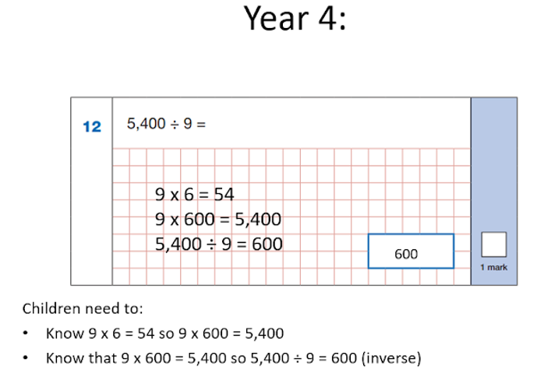

Slide 7
Children need to be able to recall the answer to any times table within 2 or 3 seconds – preferably in one second.
That leaves no time for counting the way up to the answer from 2x, 3x, 4x, etc – the answer has to pop out of memory pretty much instantly.
This level of ‘number fluency’ is the ideal foundation for any child.

Slide 8
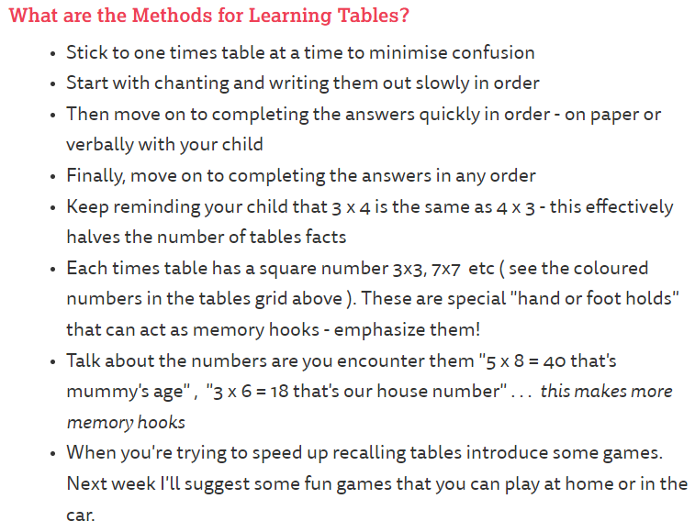

Slide 9
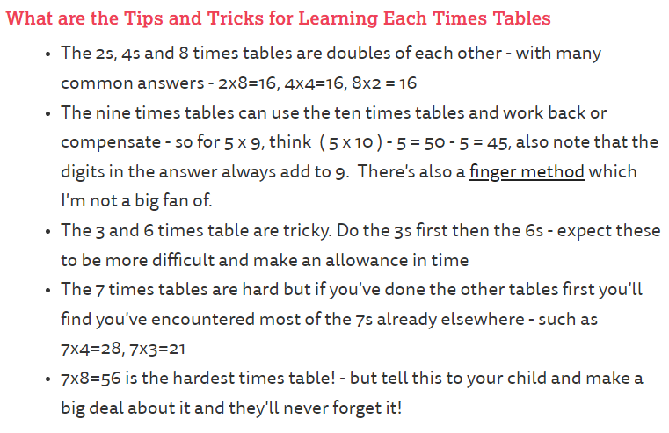

Slide 10
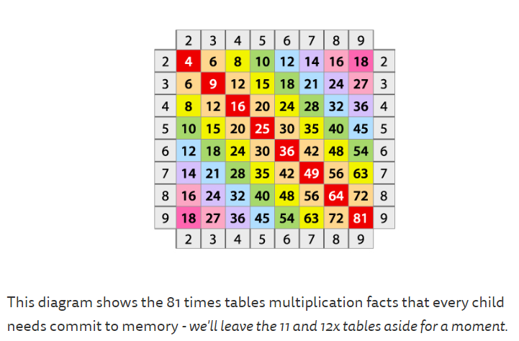

Slide 11
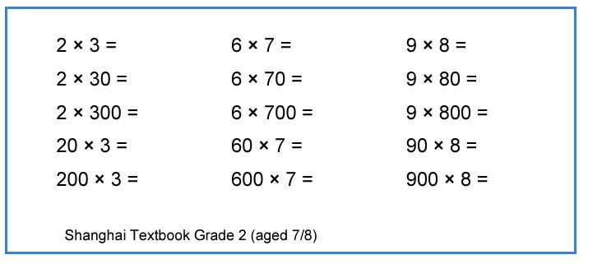
How times tables can be applied:

Slide 12
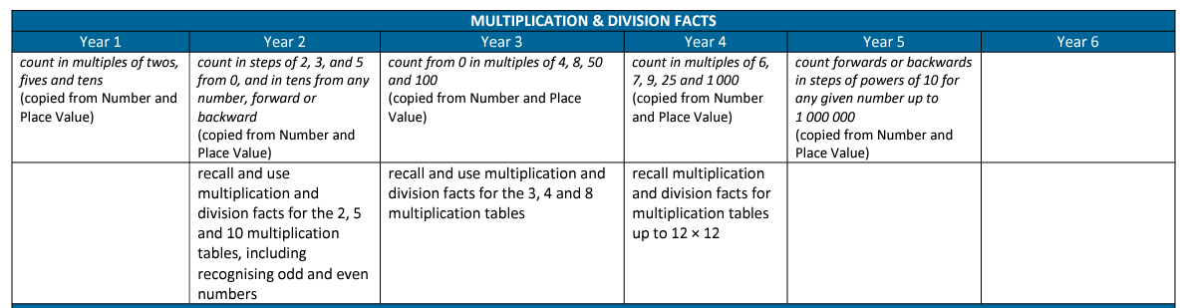

Slide 13
Year 2 children will learn to count in 2s, 5s, 10s and 3s.
Year 3 children will add their 4s and 8s, times tables.
Year 4 students will be expected to know their times tables through to 12×12, ready for the Year 4 times tables check.

Slide 14
Mental skills you can practice at home:
Times tables
Number Bonds within 10
Number Bonds to 10
Number Bonds to 20
Number Bonds to 100
Doubles
Near Doubles

Slide 15
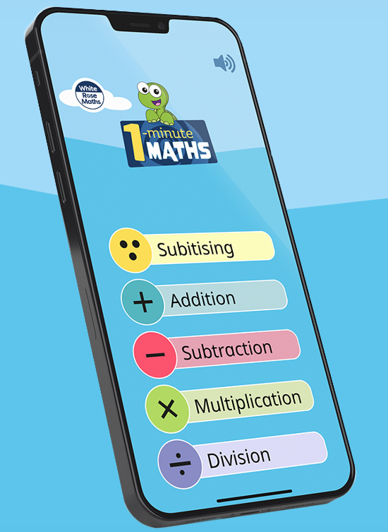
Websites to use at home:
TTRockstars - https://ttrockstars.com/
Topmarks - https://www.topmarks.co.uk/
White Rose – 1 minute maths
app.

Slide 16
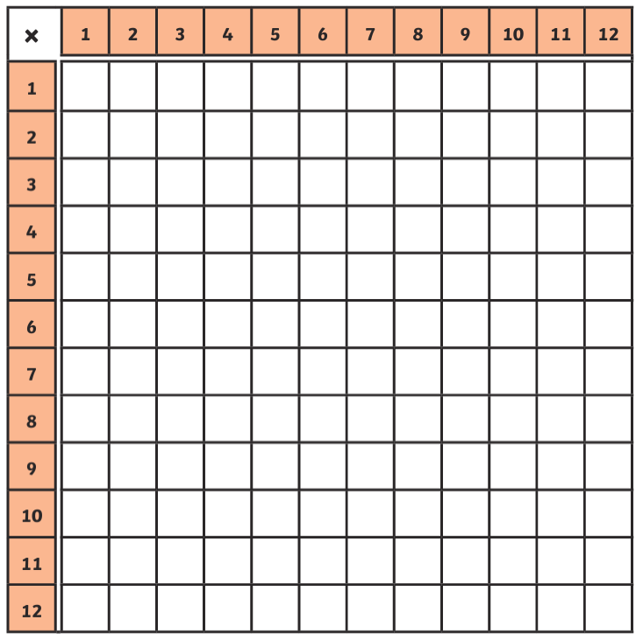

Slide 17
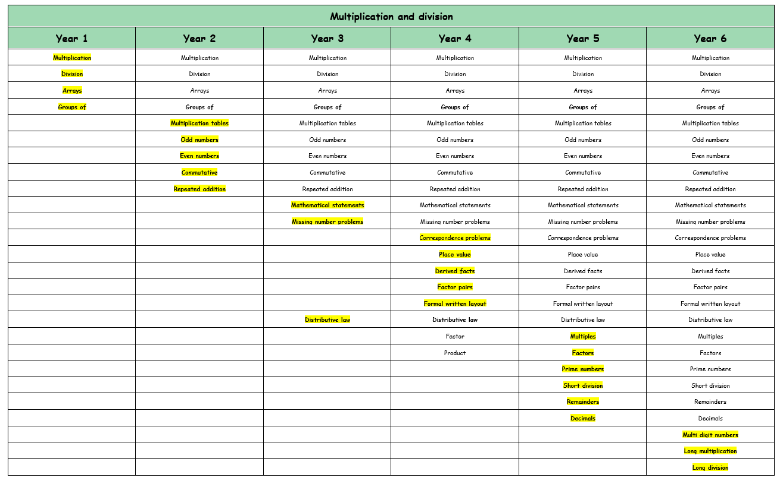

Slide 18
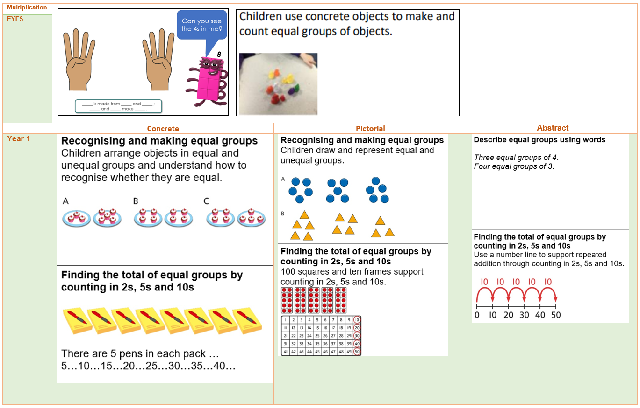

Slide 19
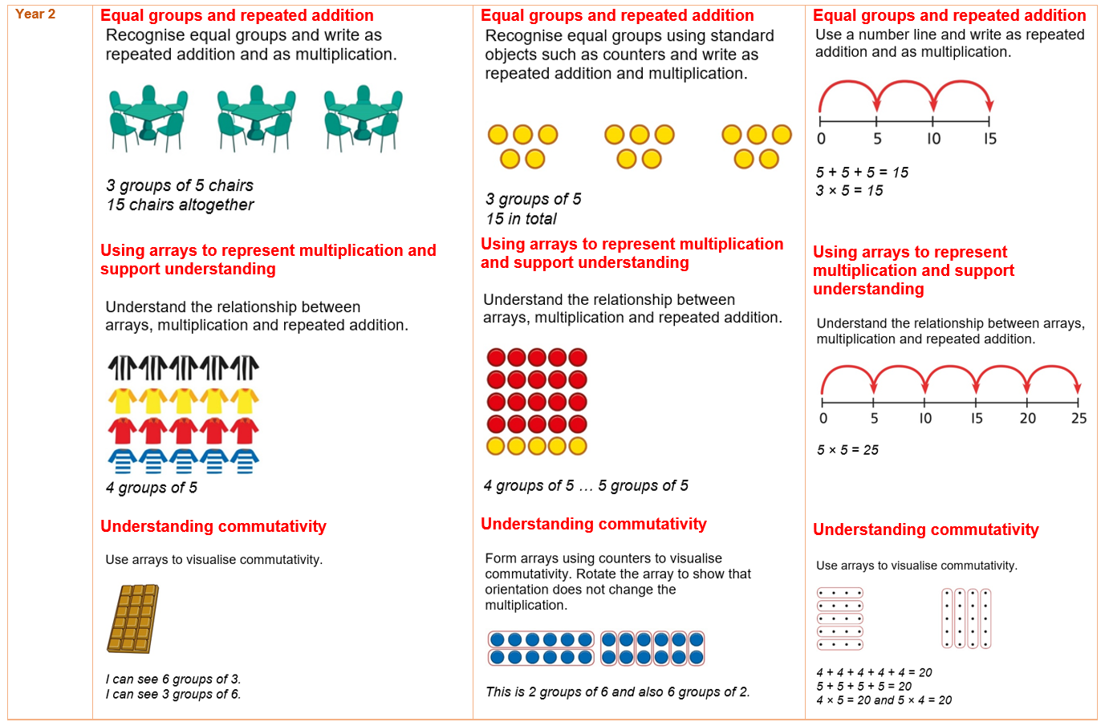

Slide 20
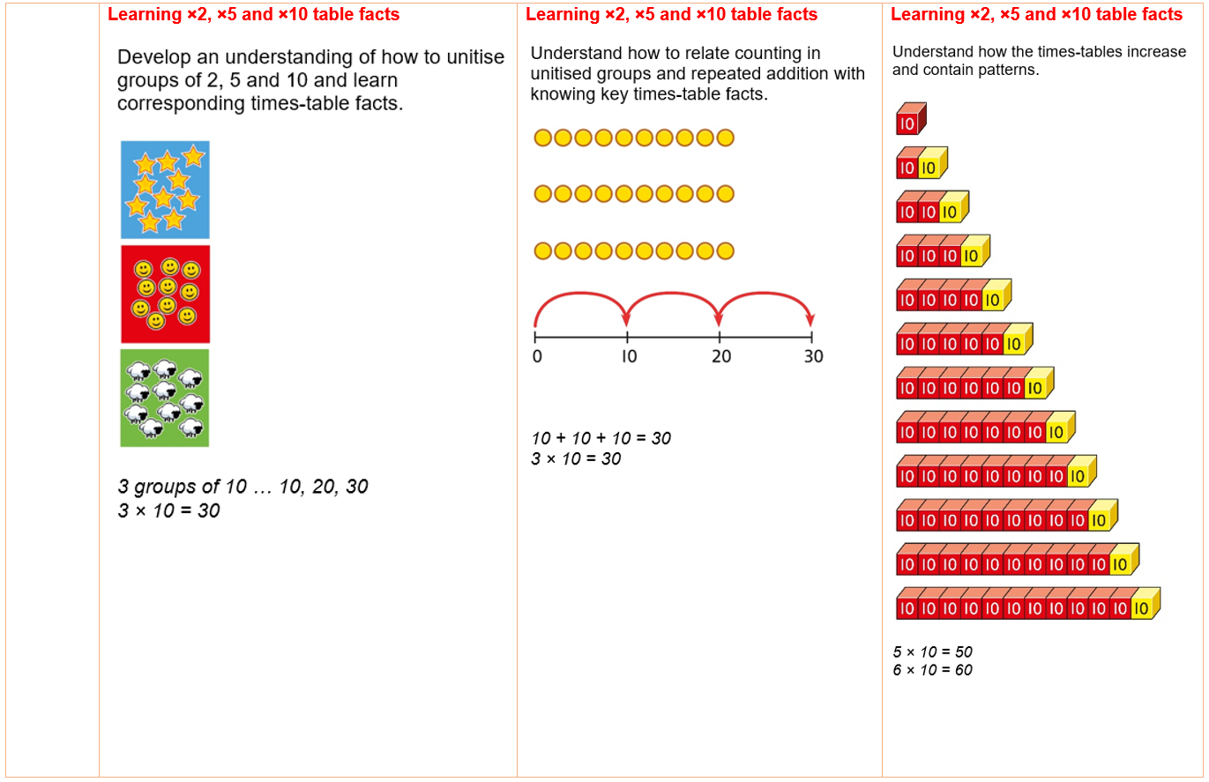

Slide 21
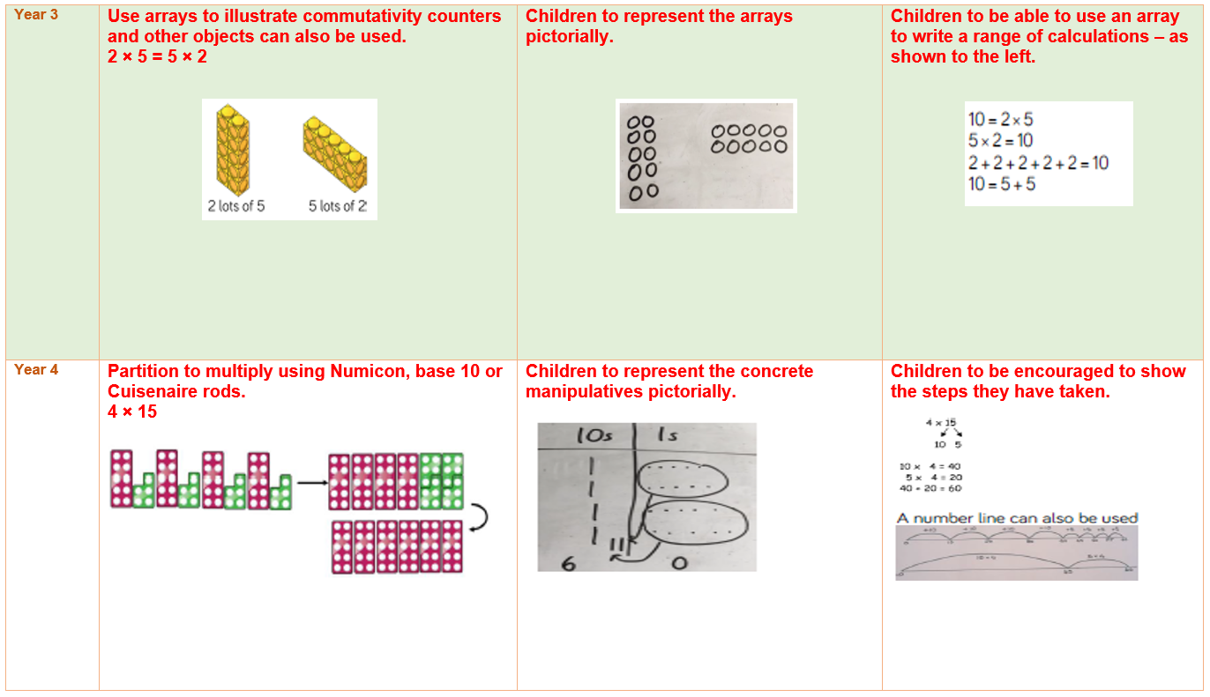

Slide 22


